Slide 1
Natural Language processing

Slide 2
Language models

Slide 3
Text Data as Sequence
Text is one of the most widespread forms of sequence data
It can be understood as either a sequence of characters or a sequence of words, but it’s most common to work at the level of words.
The deep-learning sequence-processing models introduced in the previous module can use text to produce a basic form of natural-language understanding, sufficient for applications including document classification, sentiment analysis, author identification, machine translation, Name-Entity recognition, and even question-answering (QA) (in a constrained context).
Of course none of these models are able to understand text in a human sense; rather these models can map the statistical structure of written language which is sufficient to solve many textual tasks.
Deep learning for natural-language processing is pattern recognition applied to words, sentences, and paragraphs, in much the same way that computer vision is pattern recognition applied to pixels.

Slide 4
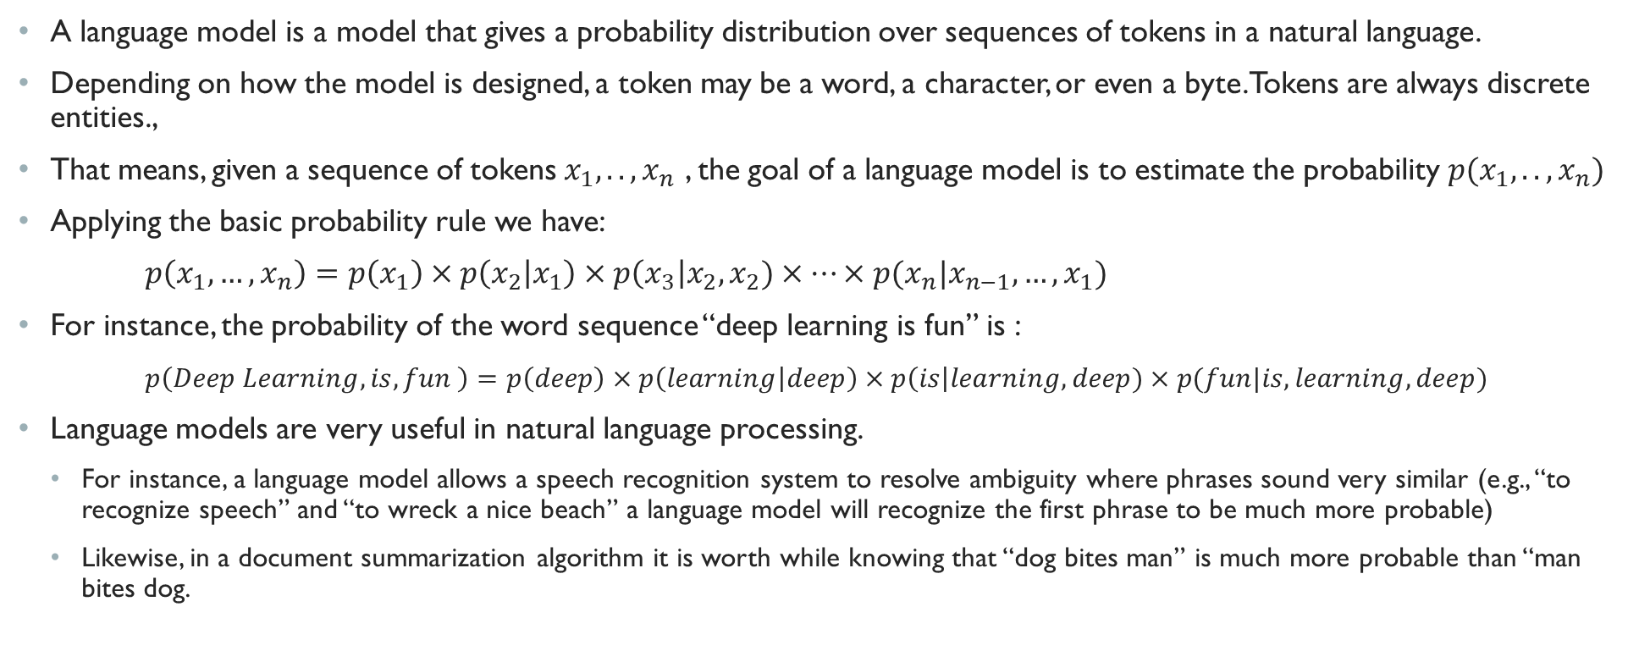
Language Model
A language model is a model that gives a probability distribution over sequences of tokens in a natural language.
Depending on how the model is designed, a token may be a word, a character, or even a byte. Tokens are always discrete entities.,
That means, given a sequence of tokens $x_{1},..,x_{n}$ , the goal of a language model is to estimate the probability $p(x_{1},..,x_{n})$
Applying the basic probability rule we have:
$p\left(x_{1},…,x_{n}\right)=p\left(x_{1}\right)×p\left(x_{2} | x_{1}\right)×p\left(x_{3}\right|x_{2},x_{2})×…×p(x_{n}|x_{n−1},…,x_{1})$
For instance, the probability of the word sequence “deep learning is fun” is :
$p\left(Deep Learning, is, fun \right)=p\left(deep\right)×p\left(learning | deep\right)×p\left(is\right|learning,deep)×p(fun|is, learning, deep)$
Language models are very useful in natural language processing.
For instance, a language model allows a speech recognition system to resolve ambiguity where phrases sound very similar (e.g., “to recognize speech” and “to wreck a nice beach” a language model will recognize the first phrase to be much more probable)
Likewise, in a document summarization algorithm it is worth while knowing that “dog bites man” is much more probable than “man bites dog.

Slide 5
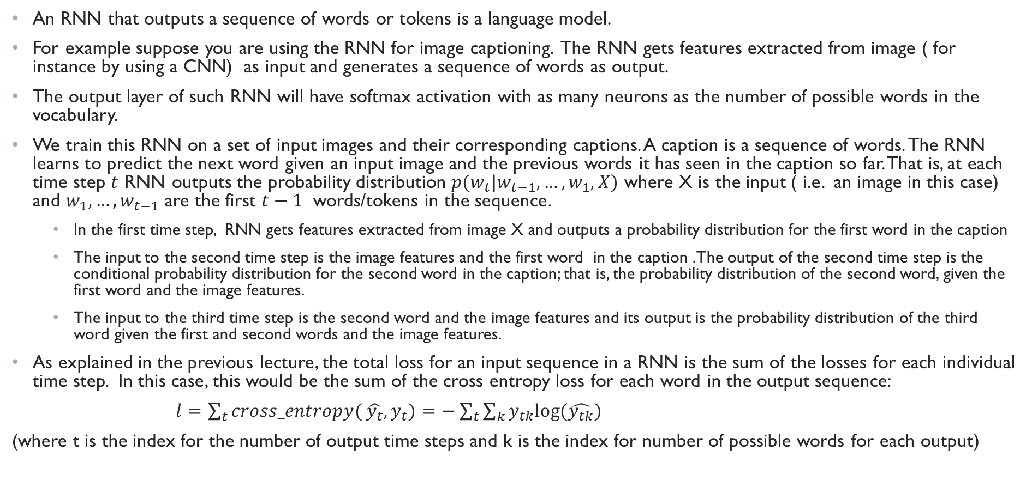
RNN and Language Models
An RNN that outputs a sequence of words or tokens is a language model.
For example suppose you are using the RNN for image captioning. The RNN gets features extracted from image ( for instance by using a CNN) as input and generates a sequence of words as output.
The output layer of such RNN will have softmax activation with as many neurons as the number of possible words in the vocabulary.
We train this RNN on a set of input images and their corresponding captions. A caption is a sequence of words. The RNN learns to predict the next word given an input image and the previous words it has seen in the caption so far. That is, at each time step $t$ RNN outputs the probability distribution $p(w_{t}|w_{t−1},…,w_{1}, X)$ where X is the input ( i.e. an image in this case) and $w_{1},…,w_{t−1}$ are the first $t−1$ words/tokens in the sequence.
In the first time step, RNN gets features extracted from image X and outputs a probability distribution for the first word in the caption
The input to the second time step is the image features and the first word in the caption .The output of the second time step is the conditional probability distribution for the second word in the caption; that is, the probability distribution of the second word, given the first word and the image features.
The input to the third time step is the second word and the image features and its output is the probability distribution of the third word given the first and second words and the image features.
As explained in the previous lecture, the total loss for an input sequence in a RNN is the sum of the losses for each individual time step. In this case, this would be the sum of the cross entropy loss for each word in the output sequence:
$l=\sum_{t}{cross_entropy(}\hat{y_{t}},y_{t})=−\sum_{t}{\sum_{k}{y_{tk}log⁡(\hat{y_{tk}})}}$
(where t is the index for the number of output time steps and k is the index for number of possible words for each output)

Slide 6
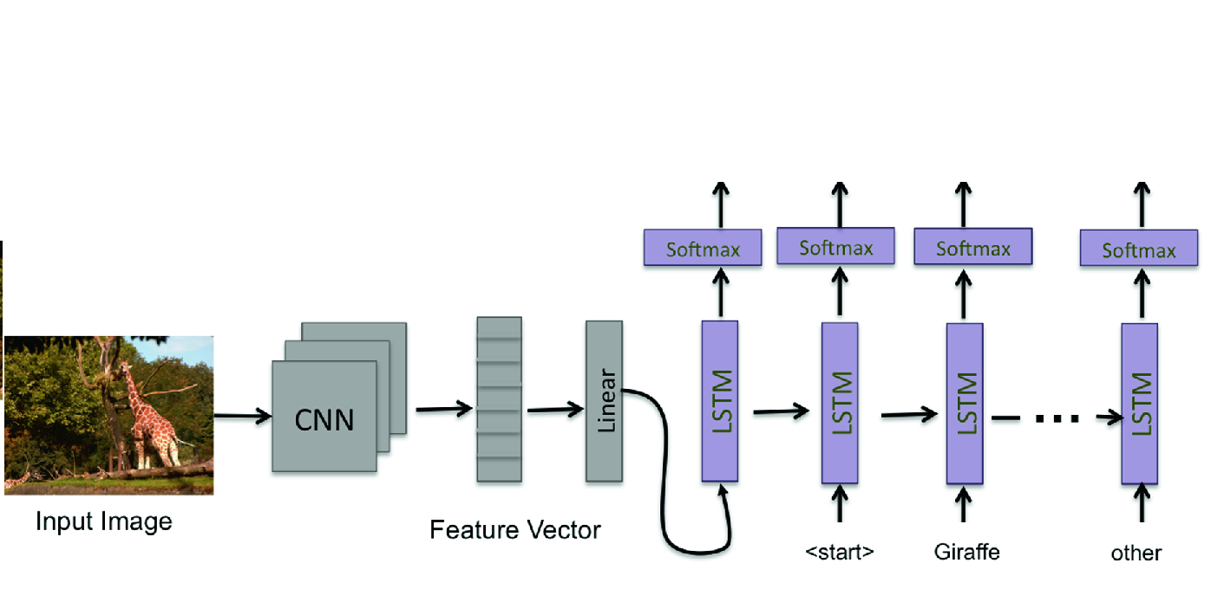

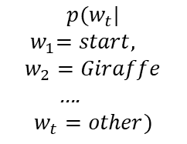
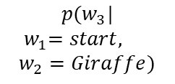

Example: Language model for image captioning
$$p(w_{t}|$$
$${ w}_{1}=start, w_{2}=Giraffe$$
….
$$w_{t}=other)$$
$$p(w_{3}|$$
$${ w}_{1}=start, w_{2}=Giraffe)$$
$$p(w_{1})$$
$$p(w_{2}|$$
$$w_{1}=start)$$
Image source: https://link.springer.com/chapter/10.1007/978-3-030-04780-1_23

Slide 7
Text representation

Slide 8
Vectorizing text
Deep-learning models don’t take raw text as input because they can only work with numeric tensors.
Vectorizing text is the process of transforming text into numeric tensors. This can be done in multiple ways:
Segment text into words, and transform each word into a vector.
Segment text into characters, and transform each character into a vector.
Extract n-grams of words or characters, and transform each n-gram into a vector. N-grams are overlapping groups of multiple consecutive words or characters. For instance, the sentence “deep learning is fun” consists of bigrams (“deep learning”, “learning is”, “is fun”) or trigrams (“deep learning is”, “learning is fun”)
Collectively, the different units into which you can break down text (words, characters, or n-grams) are called tokens, and breaking text into such tokens is called tokenization.
All text-vectorization processes consist of applying some tokenization scheme and then associating numeric vectors with the generated tokens.
There are multiple ways to associate a vector with a token. We go over two major methods:
One-hot-encoding of tokens,
Word Embeddings ( used exclusively for words)

Slide 9
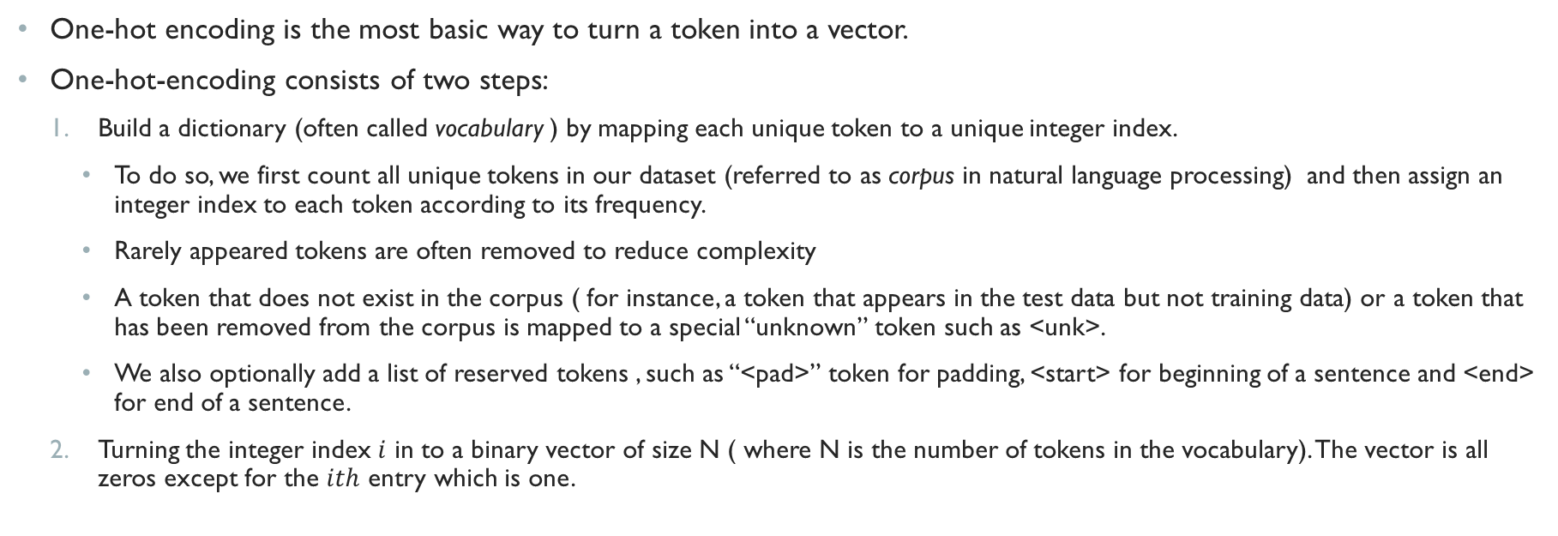
One-hot-encoding
One-hot encoding is the most basic way to turn a token into a vector.
One-hot-encoding consists of two steps:
Build a dictionary (often called vocabulary ) by mapping each unique token to a unique integer index.
To do so, we first count all unique tokens in our dataset (referred to as corpus in natural language processing) and then assign an integer index to each token according to its frequency.
Rarely appeared tokens are often removed to reduce complexity
A token that does not exist in the corpus ( for instance, a token that appears in the test data but not training data) or a token that has been removed from the corpus is mapped to a special “unknown” token such as <unk>.
We also optionally add a list of reserved tokens , such as “<pad>” token for padding, <start> for beginning of a sentence and <end> for end of a sentence.
Turning the integer index $i$ in to a binary vector of size N ( where N is the number of tokens in the vocabulary). The vector is all zeros except for the $ith$ entry which is one.

Slide 10
One-hot-encoding Example
Let’s see an example of how this is done. Suppose I have the following dataset/corpus with two simple documents/training examples:
corpus = ['<start> the cat sat on the mat <end>', '<start> the dog ate my food <end>']
Then the vocabulary would be a dictionary that maps each unique word to an integer index (suppose we reserve index 0 for unknown words)
{‘<unk>‘:0, ‘<start>': 1, 'the': 2, 'cat': 3, 'sat': 4, 'on': 5, 'mat': 6, '<end>': 7, 'dog': 8, 'ate': 9, 'my': 10, ‘food': 11}
Then the one-hot encoding of <start> the dog ate my food <end>', would be a tensor as follows:
[
[0 1 0 0 0 0 0 0 0 0 0 0]
[0 0 1 0 0 0 0 0 0 0 0 0]
[0 0 0 0 0 0 0 0 1 0 0 0]
[0 0 0 0 0 0 0 0 0 1 0 0]
[0 0 0 0 0 0 0 0 0 0 1 0]
[0 0 0 0 0 0 0 0 0 0 0 1]
[0 0 0 0 0 0 0 1 0 0 0 0]
]
Binary vector for “<start>”
Binary vector for word “the”
Binary vector for word “dog”
Binary vector for word “ate”
Binary vector for word “my”
Binary vector for word “food”
Binary vector for <end>

Slide 11
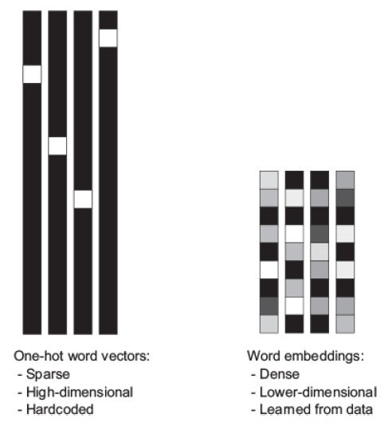
Word Embeddings
Although one-hot word vectors are easy to construct, they are usually not a good choice. For two reasons:
the vectors obtained through one-hot encoding are binary, sparse (mostly made of zeros), and very high-dimensional (same dimensionality as the number of words in the vocabulary)
One-hot-encoding cannot express the similarity between words.
The one-hot vector of “cat” is as much similar to the one-hot vector of “dog” as it is to the one hot vector of “TV”
word embeddings are low dimensional floating-point vectors (that is, dense vectors as opposed to sparse vectors)
Unlike the word vectors obtained via one-hot encoding, word embeddings are learned from data.
Word embeddings pack more information into far fewer dimensions
It’s common to see word embeddings that are 256-dimensional, 512-dimensional, or 1024-dimensional when dealing with very large vocabularies whereas one-hot encoding words generally leads to vectors that are 20,000-dimensional or greater (capturing a vocabulary of 20,000 tokens, in this case)
Source: deep learning with python, Francois Chollet,fig. 6.2

Slide 12
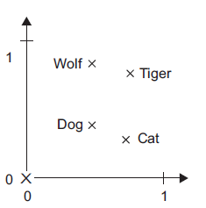
Properties of Word Embeddings
Ideally, the geometric relationships between word embedding vectors should reflect the semantic relationships between these words
In general one would expect that the geometric distance ( such as Euclidean distance) between two words to relate to their semantic distance. For instance, the embedding vector for the word “dog” to be closer to the embedding vector for the word “cat” than the word “TV”
In addition to distance, semantic relationship between words can be modeled as geometric transformation of their embedding vectors.
For instance, here is a toy example of four words embedded on a 2D plane: cat, dog, wolf, and tiger.
With the vector representations shown here, some semantic relationships between these words can be encoded as geometric transformations.
For instance, the same vector allows us to go from cat to tiger and from dog to wolf : That is:
wolf – dog= tiger -cat
Here is a website where you can play around with embedding vectors for different words and explore their relationship ( the embedding vectors here are pre-computed large corpora such as Wikipedia)
Source: deep learning with python,
Francois Chollet,fig. 6.2

Slide 13
Obtaining word embeddings
There are two ways to obtain word embeddings:
Learn word embeddings from scratch jointly with the main task you care about (such as document classification or sentiment prediction).
In this setup, you start with random word vectors and then learn word vectors in the same way you learn the weights of a neural network.
Using pre-trained word embeddings
In this setup, you use word embedding vectors precomputed on a large corpus ( such as Wikipedia) and transfer it into your model ( The concept is similar to using pre-trained convolutional neural networks)

Slide 14
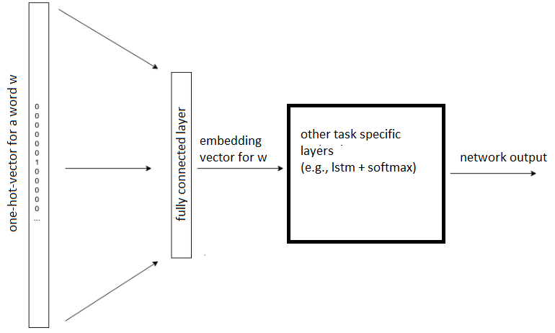
Learning word embeddings from scratch jointly with the task at hand
The goal of word embedding is to map each word to a dense vector
We can accomplish this by using a fully connected layer on top of the one-hot-encoded word vector to extract features from it. This layer is sometimes referred to as “embedding layer”
The embedding layer typically don’t have an activation function or bias term
This fully connected layer will contain much fewer neurons compared to the size of the input ( one-hot-encoded vector) forcing the network to learn a compressed representation of the input and extracting features from the one-hot input vector
The weights of this layer are learned jointly with other layers for the task at hand using backpropagation algorithm
For each one-hot input vector representing a word in the vocabulary, the output of this fully connected layer gives the embedding vector for that word.

Slide 15
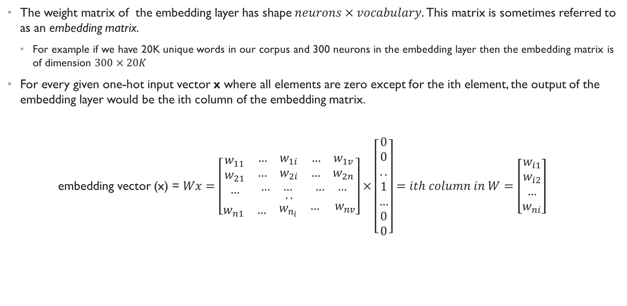
Embedding Matrix
The weight matrix of the embedding layer has shape $neurons×vocabulary.$ This matrix is sometimes referred to as an embedding matrix.
For example if we have 20K unique words in our corpus and 300 neurons in the embedding layer then the embedding matrix is of dimension $300×20K$
For every given one-hot input vector x where all elements are zero except for the ith element, the output of the embedding layer would be the ith column of the embedding matrix.
embedding vector (x) = $Wx=\left[\begin{aligned}\begin{matrix}w_{11} & \begin{matrix}… & w_{1i}\end{matrix} & \begin{matrix}… & w_{1v}\end{matrix} \\ w_{21} & \begin{matrix}… & w_{2i}\end{matrix} & \begin{matrix}… & w_{2n}\end{matrix} \\ … & \begin{matrix}… & … \end{matrix} & \begin{matrix}… & … \end{matrix}\end{matrix} \\ .. \\ \begin{matrix}w_{n1} & … & \begin{matrix}w_{n_{i}} & \begin{matrix}… & w_{nv}\end{matrix}\end{matrix}\end{matrix}\end{aligned}\right]×\left[\begin{aligned}0 \\ 0 \\ .. \\ 1 \\ … \\ 0 \\ 0\end{aligned}\right]=ith column in W=\left[\begin{aligned}w_{i1} \\ w_{i2} \\ … \\ w_{ni}\end{aligned}\right]$

Slide 16
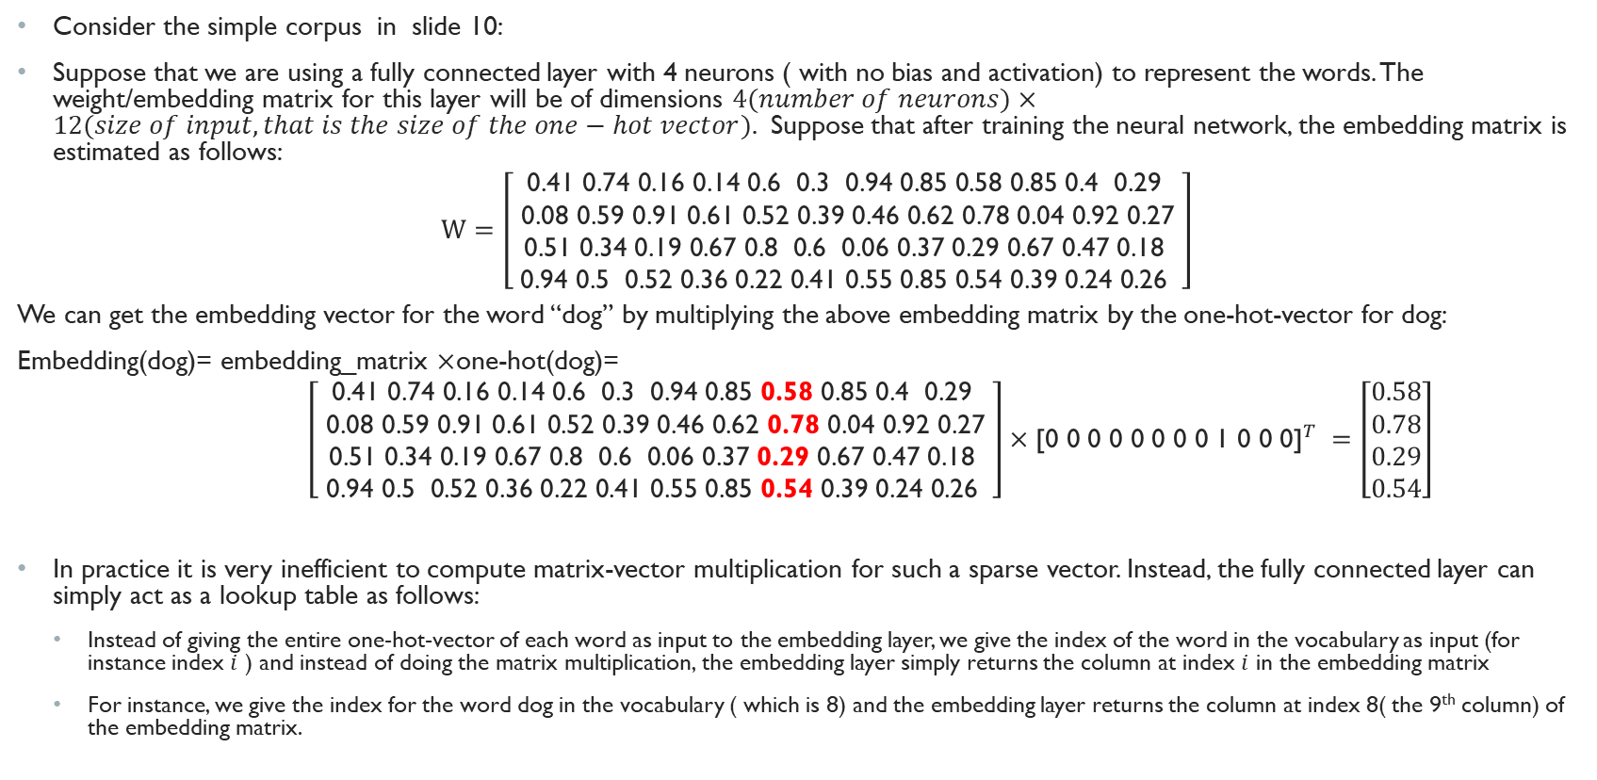
Embedding Matrix example
Consider the simple corpus in slide 10:
Suppose that we are using a fully connected layer with 4 neurons ( with no bias and activation) to represent the words. The weight/embedding matrix for this layer will be of dimensions $4(number of neurons)×12(size of input, that is the size of the one−hot vector)$. Suppose that after training the neural network, the embedding matrix is estimated as follows:
$W=\left[\begin{aligned}\text{0.41 0.74 0.16 0.14 0.6 0.3 0.94 0.85 0.58 0.85 0.4 0.29 } \\ \text{ 0.08 0.59 0.91 0.61 0.52 0.39 0.46 0.62 0.78 0.04 0.92 0.27 } \\ \text{ 0.51 0.34 0.19 0.67 0.8 0.6 0.06 0.37 0.29 0.67 0.47 0.18 } \\ \text{0.94 0.5 0.52 0.36 0.22 0.41 0.55 0.85 0.54 0.39 0.24 0.26 }\end{aligned}\right]$
We can get the embedding vector for the word “dog” by multiplying the above embedding matrix by the one-hot-vector for dog:
Embedding(dog)= embedding_matrix $×$one-hot(dog)=
$\left[\begin{aligned}\text{0.41 0.74 0.16 0.14 0.6 0.3 0.94 0.85 }\text{0.58} \text{0.85}\text{ 0.4 0.29 } \\ \text{ 0.08 0.59 0.91 0.61 0.52 0.39 0.46 0.62 }\text{0.78}\text{ 0.04 0.92 0.27 } \\ \text{ 0.51 0.34 0.19 0.67 0.8 0.6 0.06 0.37 }\text{0.29}\text{ 0.67 0.47 0.18 } \\ \text{0.94 0.5 0.52 0.36 0.22 0.41 0.55 0.85 }\text{0.54 }\text{0.39 0.24 0.26 }\end{aligned}\right]×{\text{[0 0 0 0 0 0 0 0 1 0 0 0]}}^{T} =\left[\begin{aligned}0.58 \\ 0.78 \\ 0.29 \\ 0.54\end{aligned}\right]$
In practice it is very inefficient to compute matrix-vector multiplication for such a sparse vector. Instead, the fully connected layer can simply act as a lookup table as follows:
Instead of giving the entire one-hot-vector of each word as input to the embedding layer, we give the index of the word in the vocabulary as input (for instance index $i$ ) and instead of doing the matrix multiplication, the embedding layer simply returns the column at index $i$ in the embedding matrix
For instance, we give the index for the word dog in the vocabulary ( which is 8) and the embedding layer returns the column at index 8( the 9th column) of the embedding matrix.

Slide 17
Using Pre-trained Embedding vectors
Sometimes, you have so little training data available that you can’t use your data alone to learn an appropriate task-specific embedding of your vocabulary.
In that case, Instead of learning word embeddings jointly with the problem you want to solve, you can load embedding vectors from a precomputed embedding space computed on a large corpus and capture some generic aspects on language structure
In other words, you don’t have enough data to learn truly powerful features from scratch but you expect that the features you need are fairly generic ( e.g., common semantic features). In this case it makes sense to use the features learned on a different problem (i.e., transfer learning)
Most pre-computed word embeddings are generally computed using word-coocurrence statistics.
The idea of a dense, low dimensional embedding space for words, computed in an unsupervised way, was initially explored by Bengio et al. in the early 2000s,1 but it only started to take off after the release of one of the most famous and successful word-embedding schemes, word2vec, developed by Tomas Mikolov at Google in 2013.
Another popular schemes for computing pretrained word embeddings is called Global Vectors for word Representation (Glove)
Both Glove and word2Vec algorithms are unsupervised, meaning they take a large (unlabeled) text corpus and compute vector representation of words capturing their semantic relationships.

Slide 18
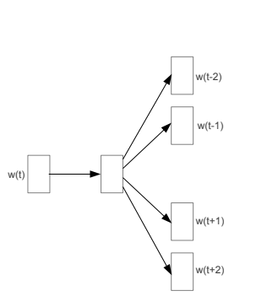
Word2Vec—Skip Gram Model
The word2Vec model comes in two flavors The Word2vec skip-gram [Mikolov et al., 2013b] and continuous bag of words (CBOW) [Mikolov et al., 2013a].
Both flavors are very similar. We will talk about the skipgram model here and point its differences with CBOW.
The idea of skipgram model is simple:
Create a neural network model with an embedding layer which takes a word as input and predicts words within a certain range ( known as window size) before and after the current word. The current surrounding words are referred to as “context” words.
Why predicting surrounding words?
The ultimate goal is not to predict the surrounding words.
The ultimate goal is to learn a good representation for the words in the vocabulary ( that is, learn a good embedding vector for the word that captures its semantics)
By learning to predict the surrounding words for each word in the corpus, the network learns the statistics from the number of times that words appear near each other in a corpus. As a results the words that appear in the same or similar context will have similar embedding vectors.
input
Embedding
layer
output

Slide 19
Example of Input output pairs for the skipgram model
Consider the tiny corpus in slide 10.
corpus = ['<start> the cat sat on the mat <end>', '<start> the dog ate my food <end>']
The training data for this small corpus with window size 2 are constructed as follows:
(x=<start>, y={the,cat})
(x=the, y={y=<start>, cat, the})
(x=cat, y={ the, <start>, sat, on})
(x=sat, y={the, cat, on, the})
…….
In practice, the training pairs are not generated for every single word in the corpus but the skipgram model restricts the vocabulary size to (let’s say 1million) frequent words.
We also subsample the words in the corpus to construct the training example in a way to counter the imbalance between very frequent words ( such as “the”) with rare words so the model won’t spend most of its time updating the embedding vector for very frequent words such as “the”.
<start> the cat
<start>
<start> > cat sat
the
<start> the sat on
cat
the cat on the
sat

Slide 20






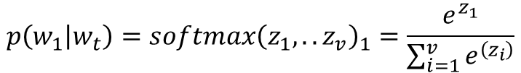
The output layer and the loss function in skipgram
The output layer of skipgram model has v neurons ( where v is the size of the vocabulary) with softmax activation.
So for every input word $w_{t}$ the output of neuron i represents the probability that the ith word in the vocabulary is a context word for $w_{t}$that is, it appears within the window size range of $w_{t}$.
The softmax layer has v neurons where v is the size of the vocabulary ( for example a vocabulary of around 700K words was used in the skipgram paper)
The embedding layers has d neurons, where d is the size of the embedding vector for each word ( around 300 in the original skipgram paper)
$$p\left(w_{1} | w_{t}\right)=softmax{\left(z_{1},..z_{v}\right)}_{1}=\frac{e^{z_{1}}}{\sum_{i=1}^{v}{e^{\left(z_{i}\right)}}}$$
$p(w_{2}|w_{t})$=$softmax{\left(z_{1},..z_{v}\right)}_{2}$
$$w_{t}$$
Embedding layer
Fully connected layer with softmax activation
$$…$$
$$…$$
$$p\left(w_{v} | w_{t}\right)=)\text{=}softmax{\left(z_{1},..z_{v}\right)}_{v}$$

Slide 21
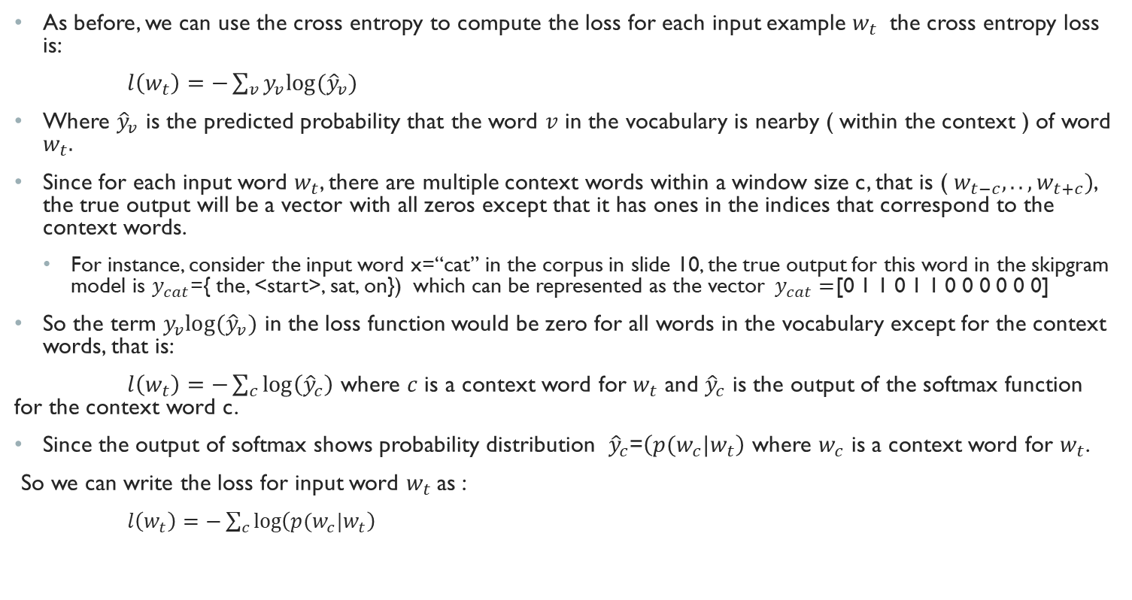
Skipgram Loss function
As before, we can use the cross entropy to compute the loss for each input example $w_{t}$ the cross entropy loss is:
$l\left(w_{t}\right)=−\sum_{v}{y_{v}log⁡({\hat{y}}_{v})}$
Where ${\hat{y}}_{v}$ is the predicted probability that the word $v$ in the vocabulary is nearby ( within the context ) of word $w_{t}.$
Since for each input word $w_{t}$, there are multiple context words within a window size c, that is ( $w_{t−c},..,w_{t+c})$, the true output will be a vector with all zeros except that it has ones in the indices that correspond to the context words.
For instance, consider the input word x=“cat” in the corpus in slide 10, the true output for this word in the skipgram model is $y_{cat}$={ the, <start>, sat, on}) which can be represented as the vector$y_{cat}=$[0 1 1 0 1 1 0 0 0 0 0 0]
So the term $y_{v}log⁡({\hat{y}}_{v})$ in the loss function would be zero for all words in the vocabulary except for the context words, that is:
$l\left(w_{t}\right)=−\sum_{c}{\log\left({\hat{y}}_{c}\right)}$ where $c$ is a context word for $w_{t}$ and ${\hat{y}}_{c}$ is the output of the softmax function for the context word c.
Since the output of softmax shows probability distribution ${\hat{y}}_{c}$=$\left(p(w_{c}|w_{t}\right)$ where $w_{c}$ is a context word for $w_{t}$.
So we can write the loss for input word $w_{t}$as :
$l\left(w_{t}\right)=−\sum_{c}{\log\left(p(w_{c}|w_{t}\right)}$

Slide 22
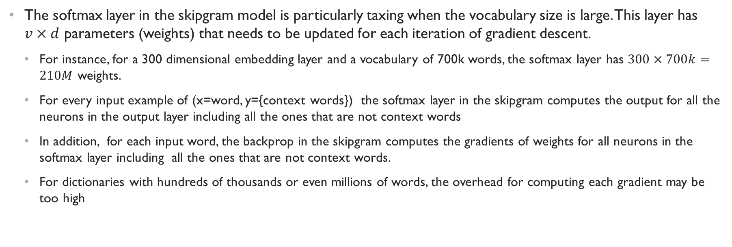
Computational Overhead of skipgram
The softmax layer in the skipgram model is particularly taxing when the vocabulary size is large. This layer has $v×d$ parameters (weights) that needs to be updated for each iteration of gradient descent.
For instance, for a 300 dimensional embedding layer and a vocabulary of 700k words, the softmax layer has $300×700k=210M$ weights.
For every input example of (x=word, y={context words}) the softmax layer in the skipgram computes the output for all the neurons in the output layer including all the ones that are not context words
In addition, for each input word, the backprop in the skipgram computes the gradients of weights for all neurons in the softmax layer including all the ones that are not context words.
For dictionaries with hundreds of thousands or even millions of words, the overhead for computing each gradient may be too high

Slide 23







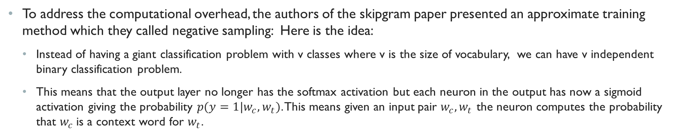
Approximate Training of the skipgram model with negative sampling
To address the computational overhead, the authors of the skipgram paper presented an approximate training method which they called negative sampling: Here is the idea:
Instead of having a giant classification problem with v classes where v is the size of vocabulary, we can have v independent binary classification problem.
This means that the output layer no longer has the softmax activation but each neuron in the output has now a sigmoid activation giving the probability $p(y=1|w_{c},w_{t})$. This means given an input pair $w_{c},w_{t}$ the neuron computes the probability that $w_{c}$is a context word for $w_{t}$.
$$p\left({y=1|w}_{1},w_{t}\right)=sigmoid\left(z_{1}\right)=\frac{1}{1+e^{−z_{1}}}$$
$$p\left({y=1|w}_{2},w_{t}\right)=sigmoid(z_{2})$$
$$p\left({y=1|w}_{3},w_{t}\right)=sigmoid(z_{3})$$
$$w_{t}$$
Embedding layer
$$…$$
$$…$$
$$p\left({y=1|w}_{v},w_{t}\right)=sigmoid(z_{v})$$

Slide 24
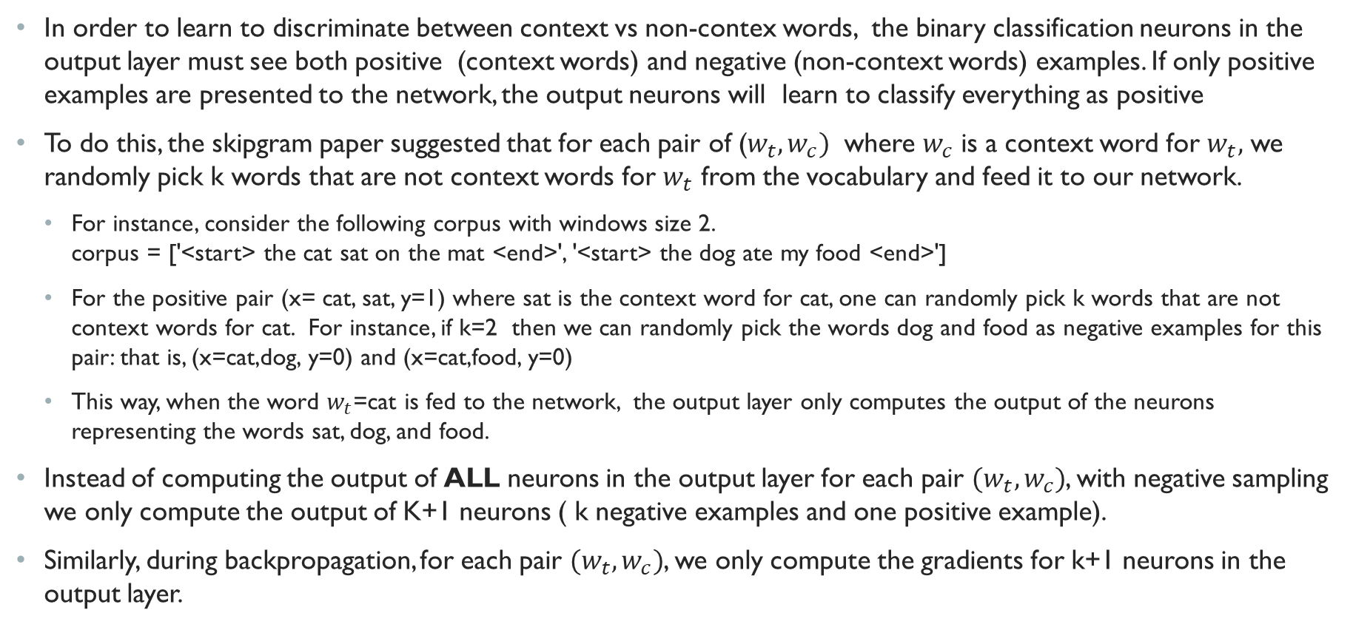
Why is it called negative sampling?
In order to learn to discriminate between context vs non-contex words, the binary classification neurons in the output layer must see both positive (context words) and negative (non-context words) examples. If only positive examples are presented to the network, the output neurons will learn to classify everything as positive
To do this, the skipgram paper suggested that for each pair of ($w_{t},w_{c})$ where $w_{c}$ is a context word for $w_{t},$ we randomly pick k words that are not context words for $w_{t}$ from the vocabulary and feed it to our network.
For instance, consider the following corpus with windows size 2. corpus = ['<start> the cat sat on the mat <end>', '<start> the dog ate my food <end>']
For the positive pair (x= cat, sat, y=1) where sat is the context word for cat, one can randomly pick k words that are not context words for cat. For instance, if k=2 then we can randomly pick the words dog and food as negative examples for this pair: that is, (x=cat,dog, y=0) and (x=cat,food, y=0)
This way, when the word $w_{t}$=cat is fed to the network, the output layer only computes the output of the neurons representing the words sat, dog, and food.
Instead of computing the output of ALL neurons in the output layer for each pair $(w_{t}, w_{c})$, with negative sampling we only compute the output of K+1 neurons ( k negative examples and one positive example).
Similarly, during backpropagation, for each pair $(w_{t}, w_{c})$, we only compute the gradients for k+1 neurons in the output layer.

Slide 25
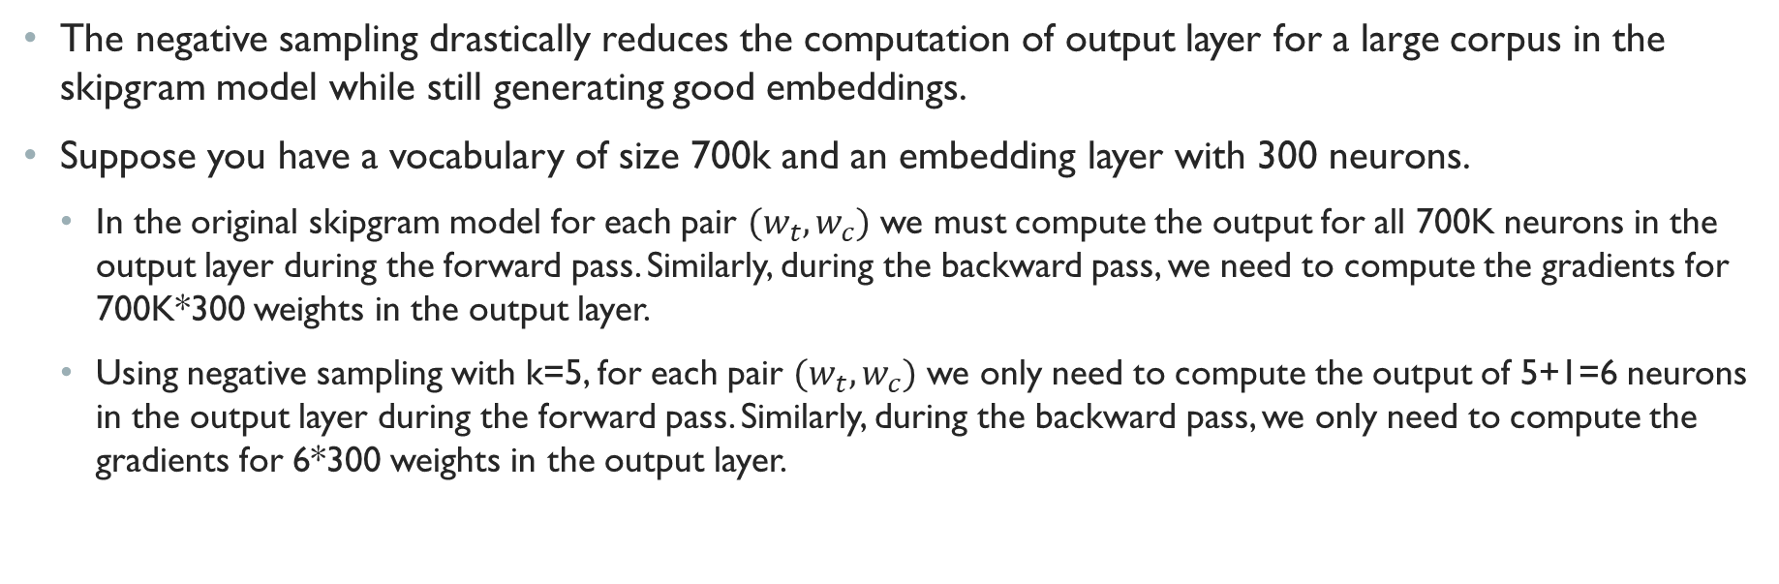
Negative sampling speeds up training
The negative sampling drastically reduces the computation of output layer for a large corpus in the skipgram model while still generating good embeddings.
Suppose you have a vocabulary of size 700k and an embedding layer with 300 neurons.
In the original skipgram model for each pair $(w_{t},w_{c})$ we must compute the output for all 700K neurons in the output layer during the forward pass. Similarly, during the backward pass, we need to compute the gradients for 700K*300 weights in the output layer.
Using negative sampling with k=5, for each pair $(w_{t},w_{c})$ we only need to compute the output of 5+1=6 neurons in the output layer during the forward pass. Similarly, during the backward pass, we only need to compute the gradients for 6*300 weights in the output layer.

Slide 26
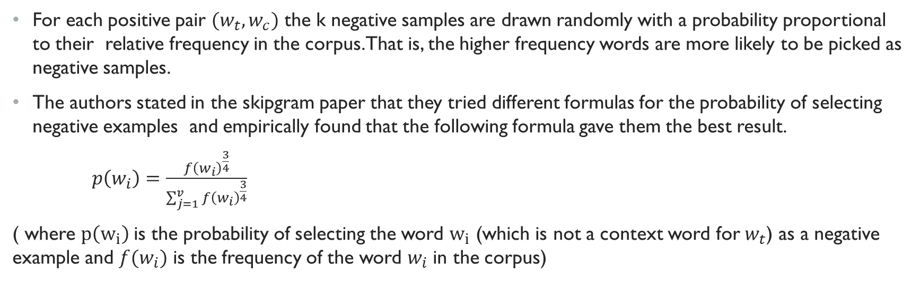
Selecting negative samples
For each positive pair $(w_{t},w_{c})$ the k negative samples are drawn randomly with a probability proportional to their relative frequency in the corpus. That is, the higher frequency words are more likely to be picked as negative samples.
The authors stated in the skipgram paper that they tried different formulas for the probability of selecting negative examples and empirically found that the following formula gave them the best result.
$p\left(w_{i}\right)=\frac{f{\left(w_{i}\right)}^{\frac{3}{4}}}{\sum_{j=1}^{v}{f{\left(w_{i}\right)}^{\frac{3}{4}}}}$
( where $p\left(w_{i}\right)$is the probability of selecting the word $w_{i}$ (which is not a context word for $w_{t}$) as a negative example and $f(w_{i})$ is the frequency of the word $w_{i}$ in the corpus)

Slide 27
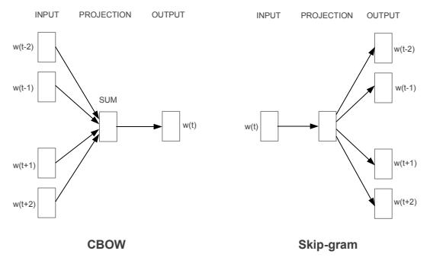
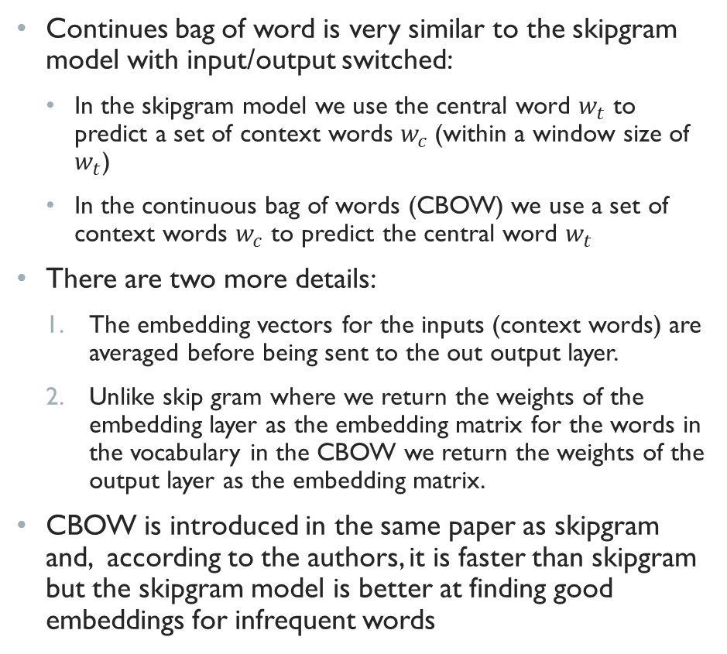
Continuous bag of words
Continues bag of word is very similar to the skipgram model with input/output switched:
In the skipgram model we use the central word $w_{t}$ to predict a set of context words $w_{c}$(within a window size of $w_{t}$)
In the continuous bag of words (CBOW) we use a set of context words $w_{c}$ to predict the central word $w_{t}$
There are two more details:
The embedding vectors for the inputs (context words) are averaged before being sent to the out output layer.
Unlike skip gram where we return the weights of the embedding layer as the embedding matrix for the words in the vocabulary in the CBOW we return the weights of the output layer as the embedding matrix.
CBOW is introduced in the same paper as skipgram and, according to the authors, it is faster than skipgram but the skipgram model is better at finding good embeddings for infrequent words
CBOW vs the skipgram model. Figure is from the original paper

Slide 28
Global Vector for Word representation
Another popular schemes for computing pretrained word embeddings in an unsupervised way from large corpora is called Global Vectors for word Representation (Glove).
Glove is developed by the Stanford Natural Language Processing group and was published a year after the word2Vec model
The main difference between Glove and skipgram model is that
To learn the word embeddings, the skipgram model trains a shallow neural network model to predict the contex words for every word in the corpus
The Glove model at the other hand learns the embeddings directly from the word-cocurrence matrix.

Slide 29
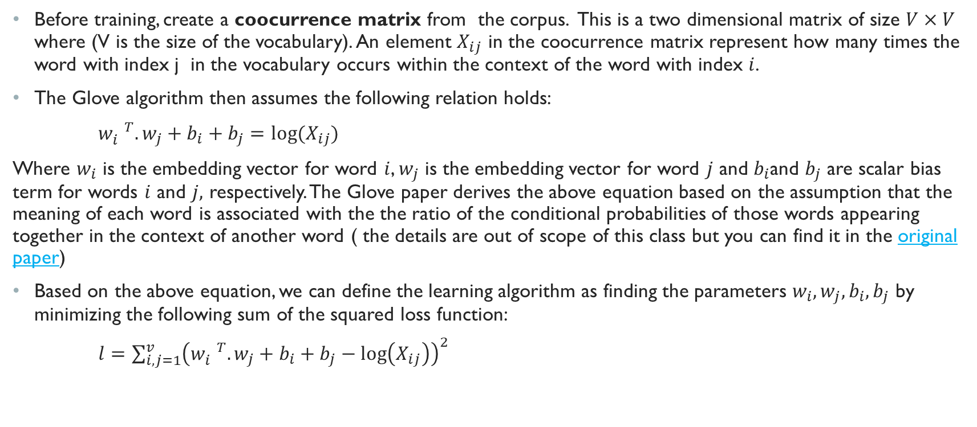
Glove Learning algorithm
Before training, create a coocurrence matrix from the corpus. This is a two dimensional matrix of size $V×V$ where (V is the size of the vocabulary). An element $X_{ij}$ in the coocurrence matrix represent how many times the word with index j in the vocabulary occurs within the context of the word with index $i$.
The Glove algorithm then assumes the following relation holds:
$w_{i}^{ T}.w_{j}+b_{i}+b_{j}=log⁡(X_{ij})$
Where $w_{i}$ is the embedding vector for word $i$, $w_{j}$ is the embedding vector for word $j$ and $b_{i}$and $b_{j}$ are scalar bias term for words $i$ and $j,$ respectively. The Glove paper derives the above equation based on the assumption that the meaning of each word is associated with the the ratio of the conditional probabilities of those words appearing together in the context of another word ( the details are out of scope of this class but you can find it in the original paper)
Based on the above equation, we can define the learning algorithm as finding the parameters $w_{i},w_{j},b_{i},b_{j}$ by minimizing the following sum of the squared loss function:
$l=\sum_{i,j=1}^{v}{{\left(w_{i}^{ T}.w_{j}+b_{i}+b_{j}−\log\left(X_{ij}\right)\right)}^{2}}$

Slide 30
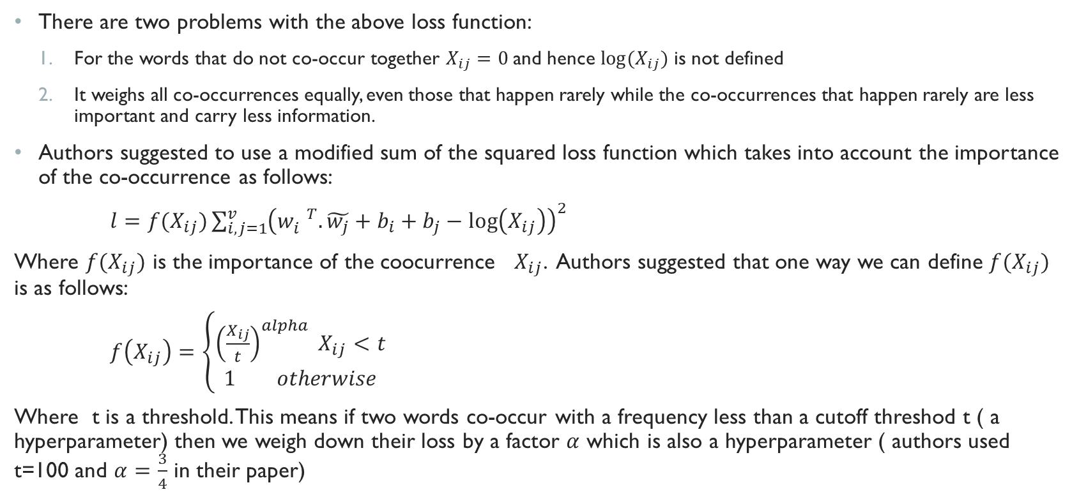
Glove Learning Algorithm (Cont.)
There are two problems with the above loss function:
For the words that do not co-occur together $X_{ij}=0$ and hence $log(X_{ij})$ is not defined
It weighs all co-occurrences equally, even those that happen rarely while the co-occurrences that happen rarely are less important and carry less information.
Authors suggested to use a modified sum of the squared loss function which takes into account the importance of the co-occurrence as follows:
$l=f(X_{ij})\sum_{i,j=1}^{v}{{\left(w_{i}^{ T}.\tilde{w_{j}}+b_{i}+b_{j}−\log\left(X_{ij}\right)\right)}^{2}}$
Where $f(X_{ij})$ is the importance of the coocurrence $X_{ij}$. Authors suggested that one way we can define $f(X_{ij})$ is as follows:
$f\left(X_{ij}\right)=\left\{\begin{aligned}{\left(\frac{X_{ij}}{t}\right)}^{alpha} X_{ij}<t \\ 1 otherwise\end{aligned}\right.$
Where t is a threshold. This means if two words co-occur with a frequency less than a cutoff threshod t ( a hyperparameter) then we weigh down their loss by a factor $α$ which is also a hyperparameter ( authors used t=100 and $α=\frac{3}{4}$ in their paper)

Slide 31
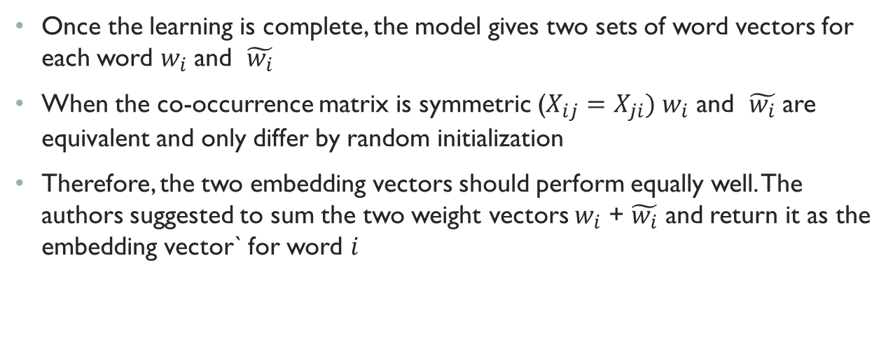
Embedding vectors in Glove
Once the learning is complete, the model gives two sets of word vectors for each word $w_{i}$ and $\tilde{w_{i}}$
When the co-occurrence matrix is symmetric ($X_{ij}=X_{ji})$ $w_{i}$ and $\tilde{w_{i}}$ are equivalent and only differ by random initialization
Therefore, the two embedding vectors should perform equally well. The authors suggested to sum the two weight vectors $w_{i}$ + $\tilde{w_{i}}$ and return it as the embedding vector` for word $i$

Slide 32
Neural machine Translation

Slide 33





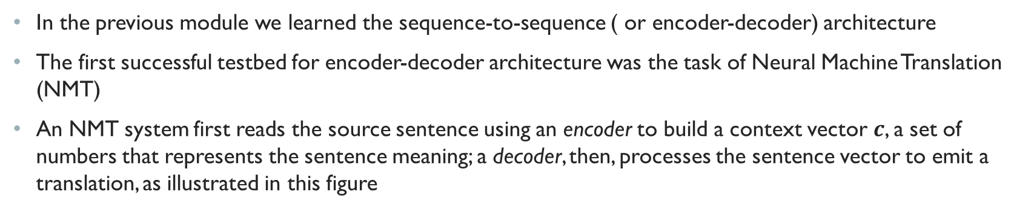






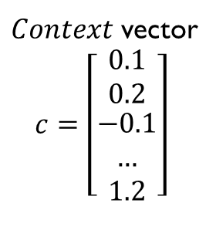
Neural Machine Translation
In the previous module we learned the sequence-to-sequence ( or encoder-decoder) architecture
The first successful testbed for encoder-decoder architecture was the task of Neural Machine Translation (NMT)
An NMT system first reads the source sentence using an encoder to build a context vector $c$, a set of numbers that represents the sentence meaning; a decoder, then, processes the sentence vector to emit a translation, as illustrated in this figure
Encoder network
Decoder network
$$Je$$
Suis
etudiant
$$h_{1}$$
$$h_{2}$$
$$h_{Tx−1}$$
$$h_{Tx}$$
$$h_{1}$$
$$h_{2}$$
$$h_{TY−1}$$
$Context$ vector
$c=\left[\begin{matrix}0.1 \\ 0.2 \\ \begin{matrix}−0.1 \\ … \\ 1.2\end{matrix}\end{matrix}\right]$
I
$$am$$
$$a$$
$$student$$

Slide 34
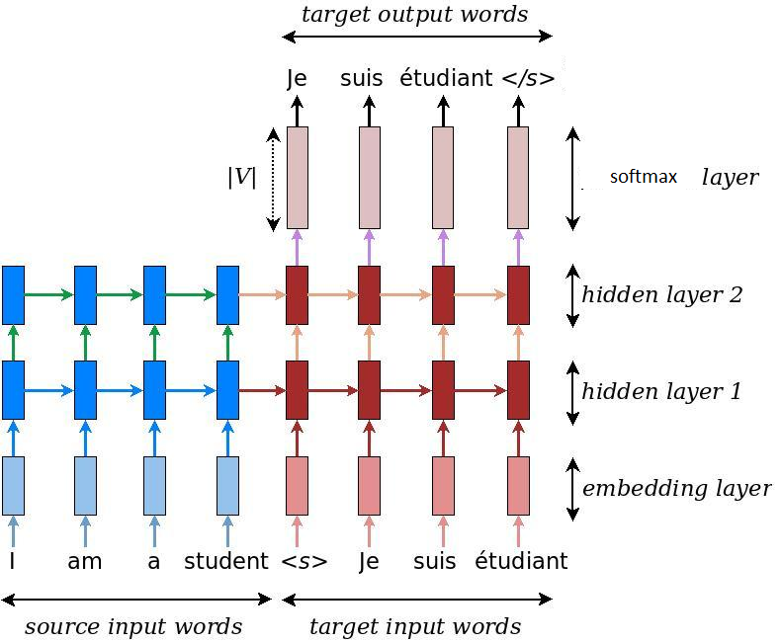
Example NMT architecture
NMT models vary in terms of their exact architectures.
A natural choice for sequential data is the recurrent neural network (RNN), used by most NMT models.
Usually an RNN is used for both the encoder and decoder.
The RNN models, however, differ in terms of: (a) directionality – unidirectional or bidirectional; (b) depth – single- or multi-layer; and (c) type – often either a vanilla RNN, a Long Short-term Memory (LSTM), or a gated recurrent unit (GRU).
More recent architectures include Transformer (Ashish Vaswani et. al ) which we do not cover here but you can read the paper if interested.
This figure shows an example encoder-decoder architecture for NMT.
Here both source and target sentences are tokenized and fed to an embedding layer to get a compact word representation
Embedding vectors are then fed to a two-layered encoder-decoder architecture.
The decoder’s state in the second hidden layer is fed to a softmax layer to compute a probability distribution over the words in the vocabulary of the target language
A greedy or beam search is used to generate the final output translation
Image source: tensorflow

Slide 35
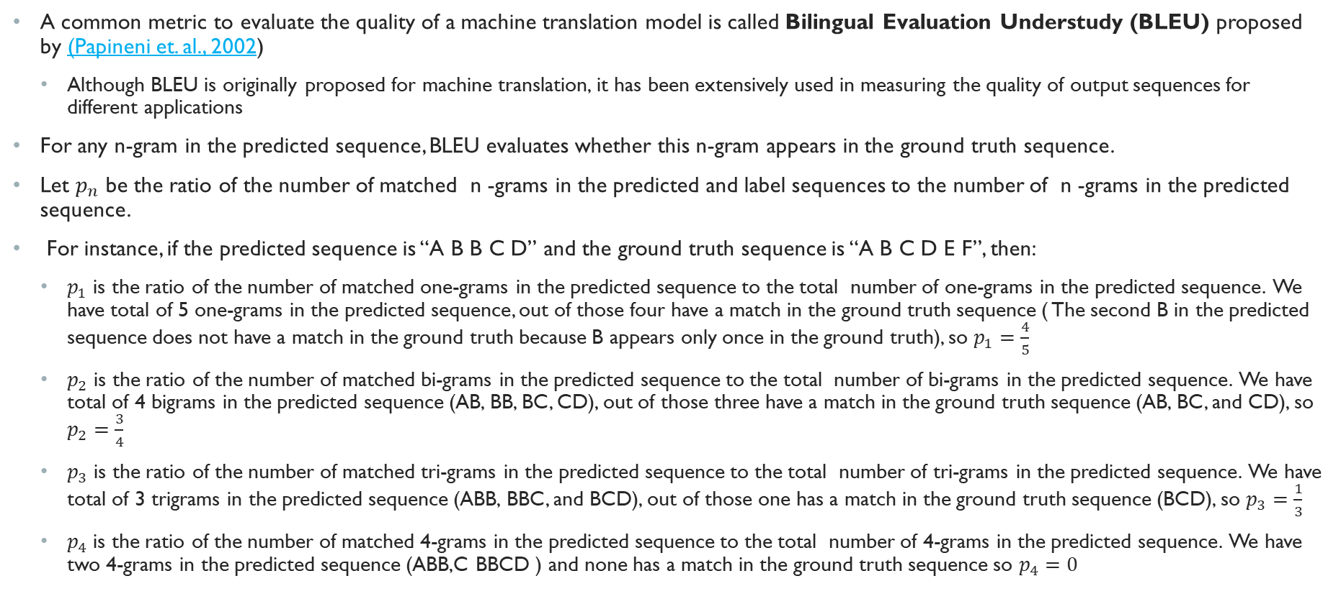
Evaluating NMT using (Bleu) score
A common metric to evaluate the quality of a machine translation model is called Bilingual Evaluation Understudy (BLEU) proposed by (Papineni et. al., 2002)
Although BLEU is originally proposed for machine translation, it has been extensively used in measuring the quality of output sequences for different applications
For any n-gram in the predicted sequence, BLEU evaluates whether this n-gram appears in the ground truth sequence.
Let $p_{n}$ be the ratio of the number of matched n -grams in the predicted and label sequences to the number of n -grams in the predicted sequence.
For instance, if the predicted sequence is “A B B C D” and the ground truth sequence is “A B C D E F”, then:
$p_{1}$ is the ratio of the number of matched one-grams in the predicted sequence to the total number of one-grams in the predicted sequence. We have total of 5 one-grams in the predicted sequence, out of those four have a match in the ground truth sequence ( The second B in the predicted sequence does not have a match in the ground truth because B appears only once in the ground truth), so $p_{1}=\frac{4}{5}$
$p_{2}$ is the ratio of the number of matched bi-grams in the predicted sequence to the total number of bi-grams in the predicted sequence. We have total of 4 bigrams in the predicted sequence (AB, BB, BC, CD), out of those three have a match in the ground truth sequence (AB, BC, and CD), so $p_{2}=\frac{3}{4}$
$p_{3}$ is the ratio of the number of matched tri-grams in the predicted sequence to the total number of tri-grams in the predicted sequence. We have total of 3 trigrams in the predicted sequence (ABB, BBC, and BCD), out of those one has a match in the ground truth sequence (BCD), so $p_{3}=\frac{1}{3}$
$p_{4}$ is the ratio of the number of matched 4-grams in the predicted sequence to the total number of 4-grams in the predicted sequence. We have two 4-grams in the predicted sequence (ABB,C BBCD ) and none has a match in the ground truth sequence so $p_{4}=0$

Slide 36
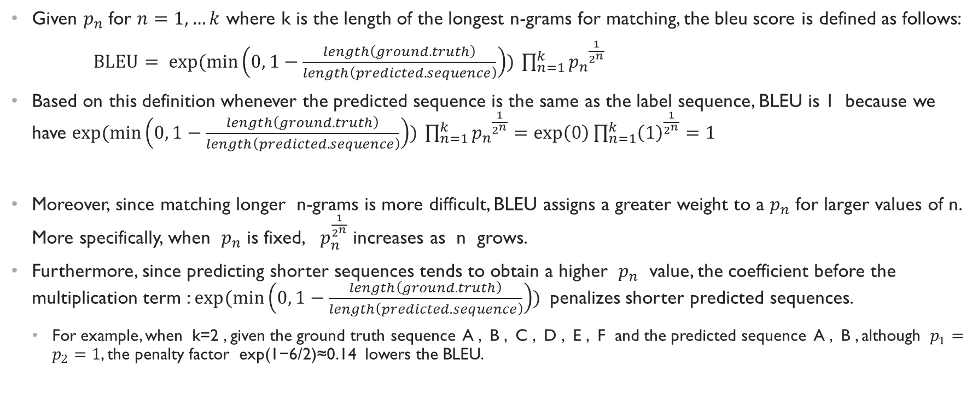
BLEU score (cont.)
Given $p_{n}$ for $n=1,…k$ where k is the length of the longest n-grams for matching, the bleu score is defined as follows:
$BLEU= exp⁡(\min\left(0, 1−\frac{length\left(ground.truth\right)}{length\left(predicted.sequence\right)}\right)) {\prod_{n=1}^{k}{p_{n}}}^{\frac{1}{2^{n}}}$
Based on this definition whenever the predicted sequence is the same as the label sequence, BLEU is 1 because we have $exp⁡(\min\left(0, 1−\frac{length\left(ground.truth\right)}{length\left(predicted.sequence\right)}\right)) {\prod_{n=1}^{k}{p_{n}}}^{\frac{1}{2^{n}}}=\exp\left(0\right){\prod_{n=1}^{k}{\left(1\right)}}^{\frac{1}{2^{n}}}=1$
Moreover, since matching longer n-grams is more difficult, BLEU assigns a greater weight to a $p_{n}$ for larger values of n. More specifically, when $p_{n}$ is fixed, $p_{n}^{\frac{1}{2^{n}}}$ increases as n grows.
Furthermore, since predicting shorter sequences tends to obtain a higher $p_{n}$ value, the coefficient before the multiplication term : $exp⁡(\min\left(0, 1−\frac{length\left(ground.truth\right)}{length\left(predicted.sequence\right)}\right))$ penalizes shorter predicted sequences.
For example, when k=2 , given the ground truth sequence A , B , C , D , E , F and the predicted sequence A , B , although $p_{1}=p_{2}=1$, the penalty factor exp(1−6/2)≈0.14 lowers the BLEU.

Slide 37
End of lecture

